Slide 1

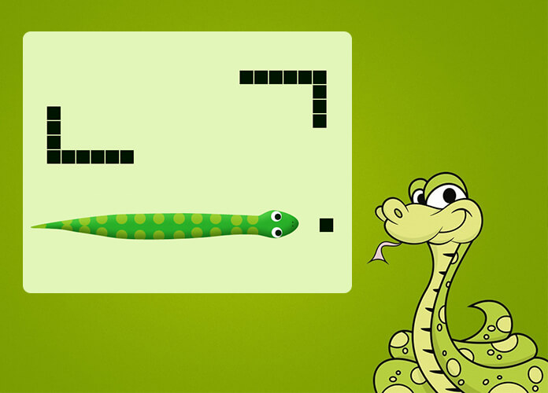
Snake game with reinforcement learning
Shafahat sardarov
Khurram hAjizada
Rashad gasimov

Slide 2
Introduction
Snake is a sole player video game where the player controls a line to eat items by running into them with the head of the line. Each item eaten makes the snake longer, so controlling is progressively more difficult. It becomes primary obstacle to itself as it grows.
The player controls a dot, square, or object on a bordered plane. As it moves forward, it leaves a trail behind, resembling a moving snake

Slide 3

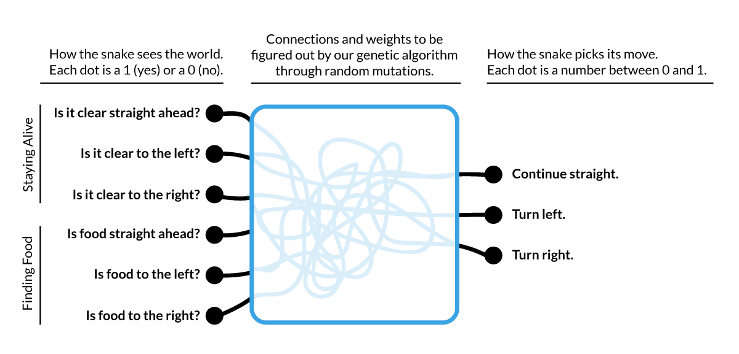

Slide 4
What is reinforcement learning ?
Reinforcement learning (RL) is an area of machine learning concerned with how software agents ought to take actions in an environment in order to maximize some notion of cumulative reward.
Important ideas in reinforcement learning that came up
Exploration: you have to try unknown actions to get information
Exploitation: eventually, you have to use what you know
Regret: even if you learn intelligently, you make mistakes
Sampling: because of chance, you have to try things repeatedly
Difficulty: learning can be much harder than solving a known MDP

Slide 5
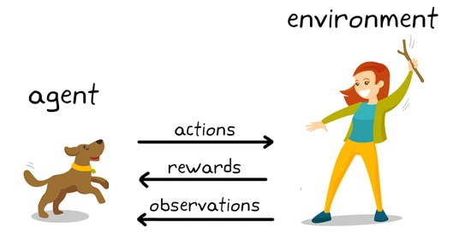
Basic idea:
Receive feedback in the form of rewards
Agent’s utility is defined by the reward function
Must (learn to) act so as to maximize expected rewards
All learning is based on observed samples of outcomes!

